Slide 2
Lost in Translation: PrEP Implementation & Transgender People
Asa Radix, MD, MPH
@AsaRadix
Share your thoughts on this presentation with #IAS2019

Slide 3
Disclosures
No Conflicts of Interest to Disclose

Slide 4
Sex & Gender
Sex
Assigned at birth: male, female
Based on biology: anatomy, chromosomes, hormones
Gender Identity
One’s sense of self as a gendered or non-gendered person (man, woman, both, neither)
Children aware of gender differences by ages 1-3 years
Can label themselves boy/girl by age 3
Gender constancy age 4
Campbell et al,. Br. J. Psychol, 2002; Zosuls et al., Dev Psychol 2009;
Martin et al,. Annu Rev Psychol 2010; Zmyj & Bischof-Köhler, J Cognition Dev 2015

Slide 5
Transgender Populations
two spirit, travesti, meti, waria, hijra, kothi fa'afafine, travesti, kinnar, genderqueer transpinoy, aravani, aruvani, jagappa, shiv-shakthis, jogti hijras, third gender, trans thirunangi, twin spirit muxhe omeguid leiti mahu
People whose gender identity or expression is different from their sex assigned at birth
Cultural/linguistic differences
Transgender women: people who were assigned male at birth but identify as women
Transgender men: people who were assigned female at birth but identify as men
Other genders: nonbinary, genderqueer, gender nonconforming, agender, gender expansive

Slide 6
Global Estimates of Transgender Persons
Approximately 25 million transgender people worldwide
USA
1 million trans adults (0.4%)
2% of US high school students
Europe (UK, Belgium, Netherlands) 0.6-0.9%
Winter S, Lancet. 2016; Meerwijk & Sevelius. AJPH, 2017; Johns MM, MMWR 2019; Glenn & Hurrell, Equality and Human Rights
Commission 2012; Kuyper and Wijsen, Arch Sex Behav 2014; Van Caenegem et al. Arch Sex Behav 2015; Winter, et al. Lancet 2016

Slide 7
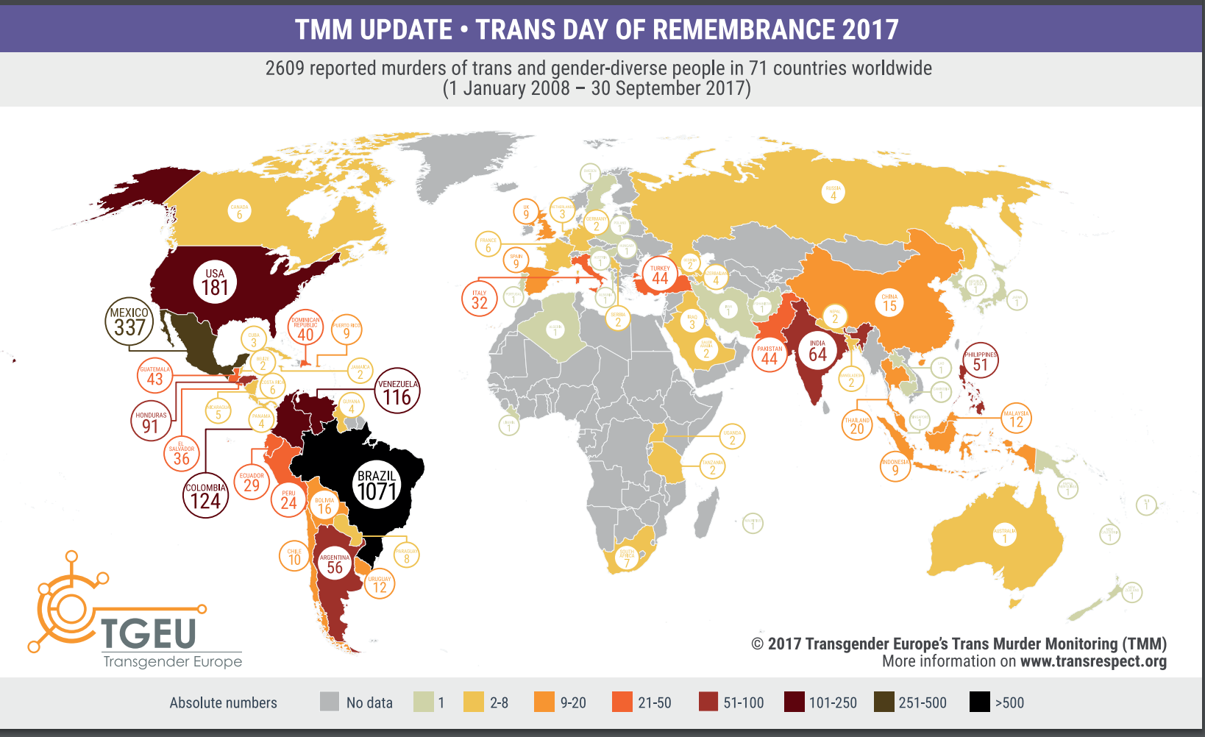
35% trans youth bullied in schools
– Johns MMWR 2019
47% face family rejection
– USTS 2015
40% reported ever attempting suicide
10% within the last year
– USTS 2015, Bauer 2015
29% live in poverty
– USTS 2015
14% experienced homelessness
– USTS 2015
1 in 3 faced discrimination in healthcare settings
– USTS 2015
1 in 4 avoided medical care due to fear of mistreatment
– USTS 2015
https://transrespect.org/en/trans-murder-monitoring/tmm-resources/
Notes:
One-third (33%) of those who saw a health care provider in the past year reported having at least one negative experience related to being transgender, with higher rates for people of color and people with disabilities. This included being refused treatment, verbally harassed, or physically or sexually assaulted, or having to teach the provider about transgender people in order to get appropriate care.

Slide 8
https://transrespect.org/en/trans-murder-monitoring/tmm-resources/

Slide 9
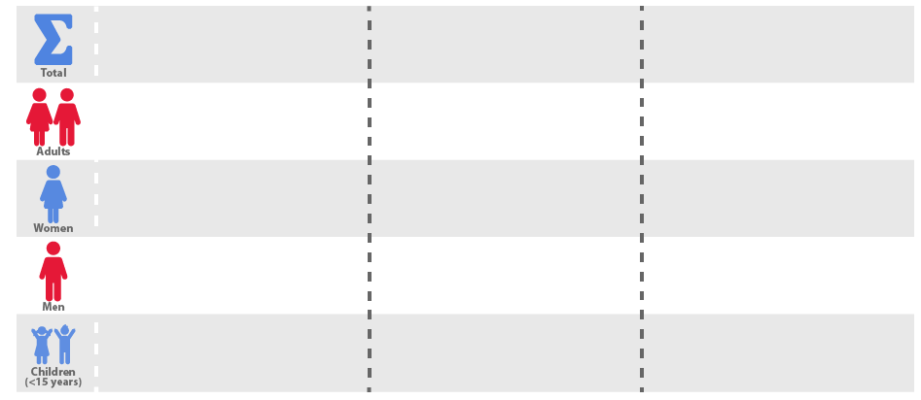
Summary of the Global HIV Epidemic (2017)
People living with HIV in 2017
People newly infected with HIV in 2017
HIV-related deaths 2017
36.9 million
[31.1 million – 43.9 million]
1.8 million
[1.4 million – 2.4 million]
940 000
[670 000 – 1.3 million]
35.1 million
[29.6 million – 41.7 million]
1.6 million
[1.3 million – 2.1 million]
830 000
[590 000 – 1.2 million]
18.2 million
[15.6 million – 21.4 million]
–
–
16.8 million
[13.9 million – 20.4 million]
–
–
1.8 million
[1.3 million – 2.4 million]
180 000
[110 000 – 260 000]
110 000
[63 000 – 160 000]
Source: UNAIDS/WHO estimates

Slide 10
“What message are we sending to young people who are trans and gender-nonconforming when we don’t even count them?
- Laverne Cox 2015
We suggest that their identities don’t even matter.”
Image: https://www.mic.com
2015 Social Good Summit Sept. 28, 2015.

Slide 11
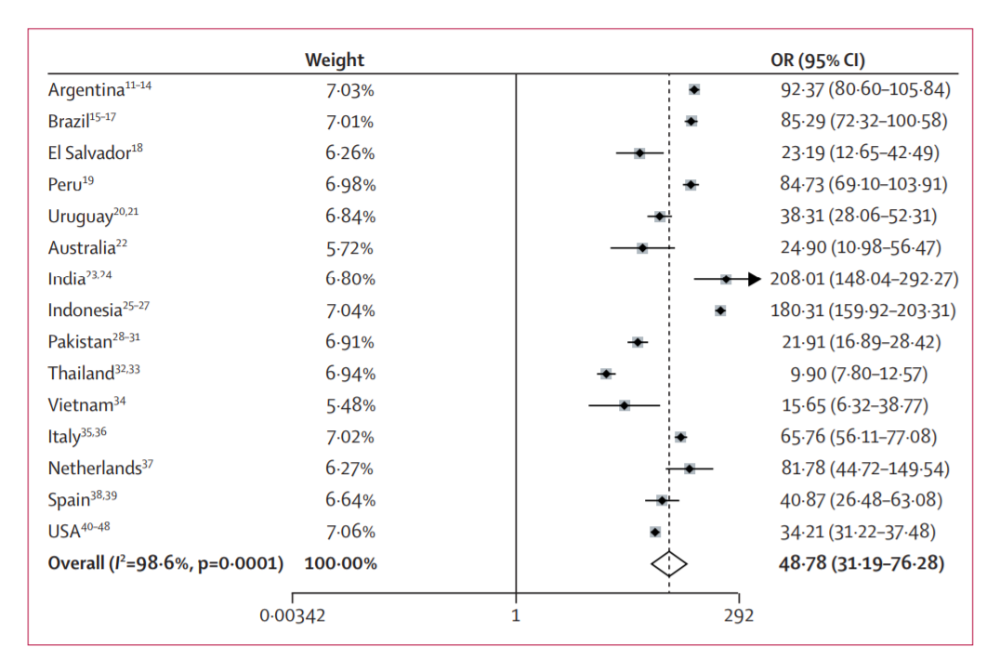
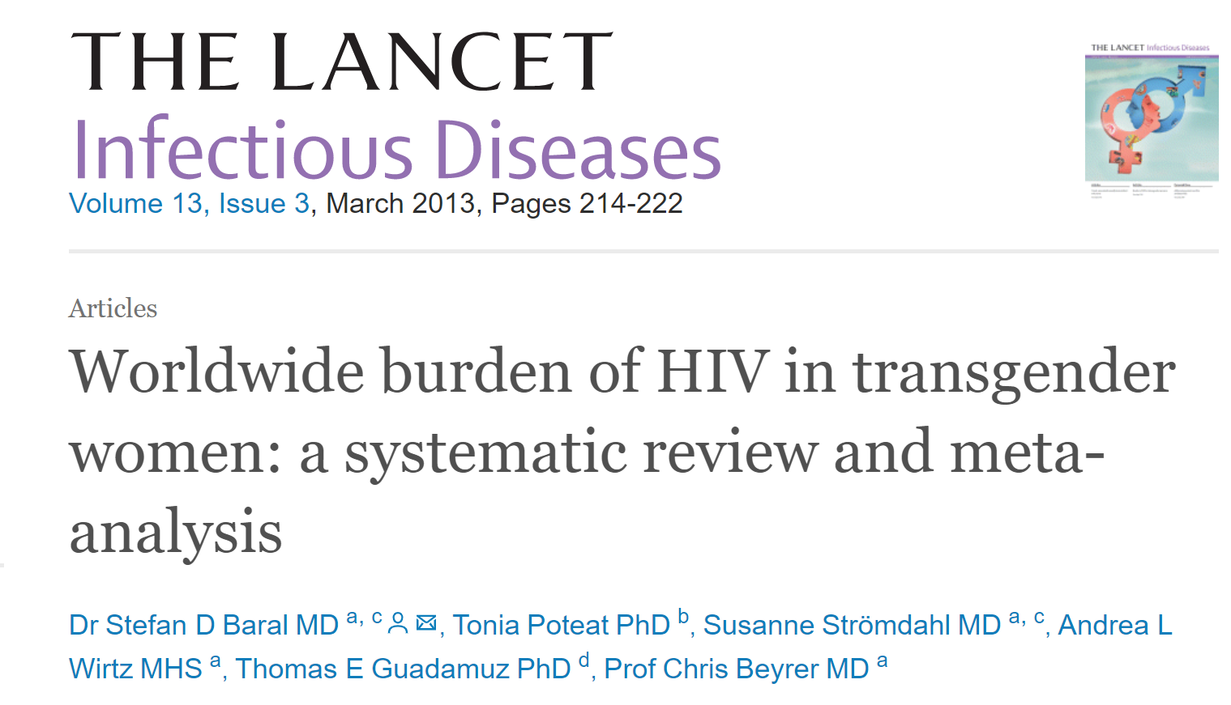
Global Burden of HIV in Transgender Women
39 studies, 15 countries:
Pooled HIV prevalence of 19.1% (95% CI 17.4–20.7) in 11,066 transgender women worldwide
OR 49-fold higher than general population

Slide 12
Global burden of HIV among Transmasculine Persons
Quantitative data very limited^{1,2}
Lab-confirmed HIV+: 0-4%
Self-report: 0-10%
Choosing the right denominator
- e.g., 63% of trans men identified as gay, bi, queer but only 1/3 of this group had sex with cis men³
¹ Reisner & Murchison. Global Public Health. 2016.
² Poteat et al. JAIDS. 2016.
³ Scheim et al. JAIDS. 2017.
Slide: A. Scheim

Slide 13
HIV Incidence Transgender Women
Criteria for PrEP
WHO 2015:
Incidence > 3 per 100 person-years
IAS-USA guidelines:
Incidence > 2 per 100 person-years
Spain: 1.2/100 p-y
Peru: 2.3/100 p-y
USA: 2.8/100 p-y
iPrEX: 3.6/ 100 p-y
Argentina: 10.7 per 100 p-y
Kenya 20 per 100 p-y
Castillo R, JAIDS 2015; Diez M, Euro Surveill. 2014; Buchbinder SP, Lancet Infect Dis. 2014; Nuttbrock L, AIDS Behav. 2015;Buchbinder SP, Lancet Infect Dis. 2014; Kimani M JIAS 2019

Slide 14
PrEP: Results from Clinical Trials
Clinical trial | Participants | Number | Drug | Modified ITT efficacy of % reduction in acquisition of HIV infectionª |  | Adherence-adjusted efficacy based on drug detection in blood^{b}
 |  |  |  | % | (95% CI) | % | (95% CI)
iPrEx | Men who have sex with men & transgender women | 2499 | FTC-TDF | 44 | (15-63) | 92 | (40-99)
Partners PrEP | HIV discordant couples | 4747 | TDF FTC-TDF | 67 75 | (44-81) (55-87) | 86 90 | (67-94) (58-98)
TDF2 | Heterosexually active men and women | 1219 | FTC-TDF | 63 | (22-83) | 85^{c} | NS^{c}
Bangkok Tenofovir Study | Injection drug users | 2411 | TDF | 49 | (10-72) | 74 | (17-94)
Fem-PrEP | Heterosexually active women | 2120 | FTC-TDF | NR | ----- | NR | -----
VOICE | Heterosexually active women | 5029 | TDF FTC-TDF | NR | ----- | NR | -----
Excluded only those enrolled patients later found to be infected at randomization and those with no follow-up visit or HIV test.
The percentage of reduction in HIV incidence among those with tenofovir detected in blood, compared with those without detectable tenofovir.
Finding not statistically significant.
US Public Health Services. Pre-exposure Prophylaxis for The Prevention Of HIV Infection In The United States, 2014. http://www.cdc.gov/hiv/pdf/guidelines/PrEPguidelines2014.pdf.

Slide 15
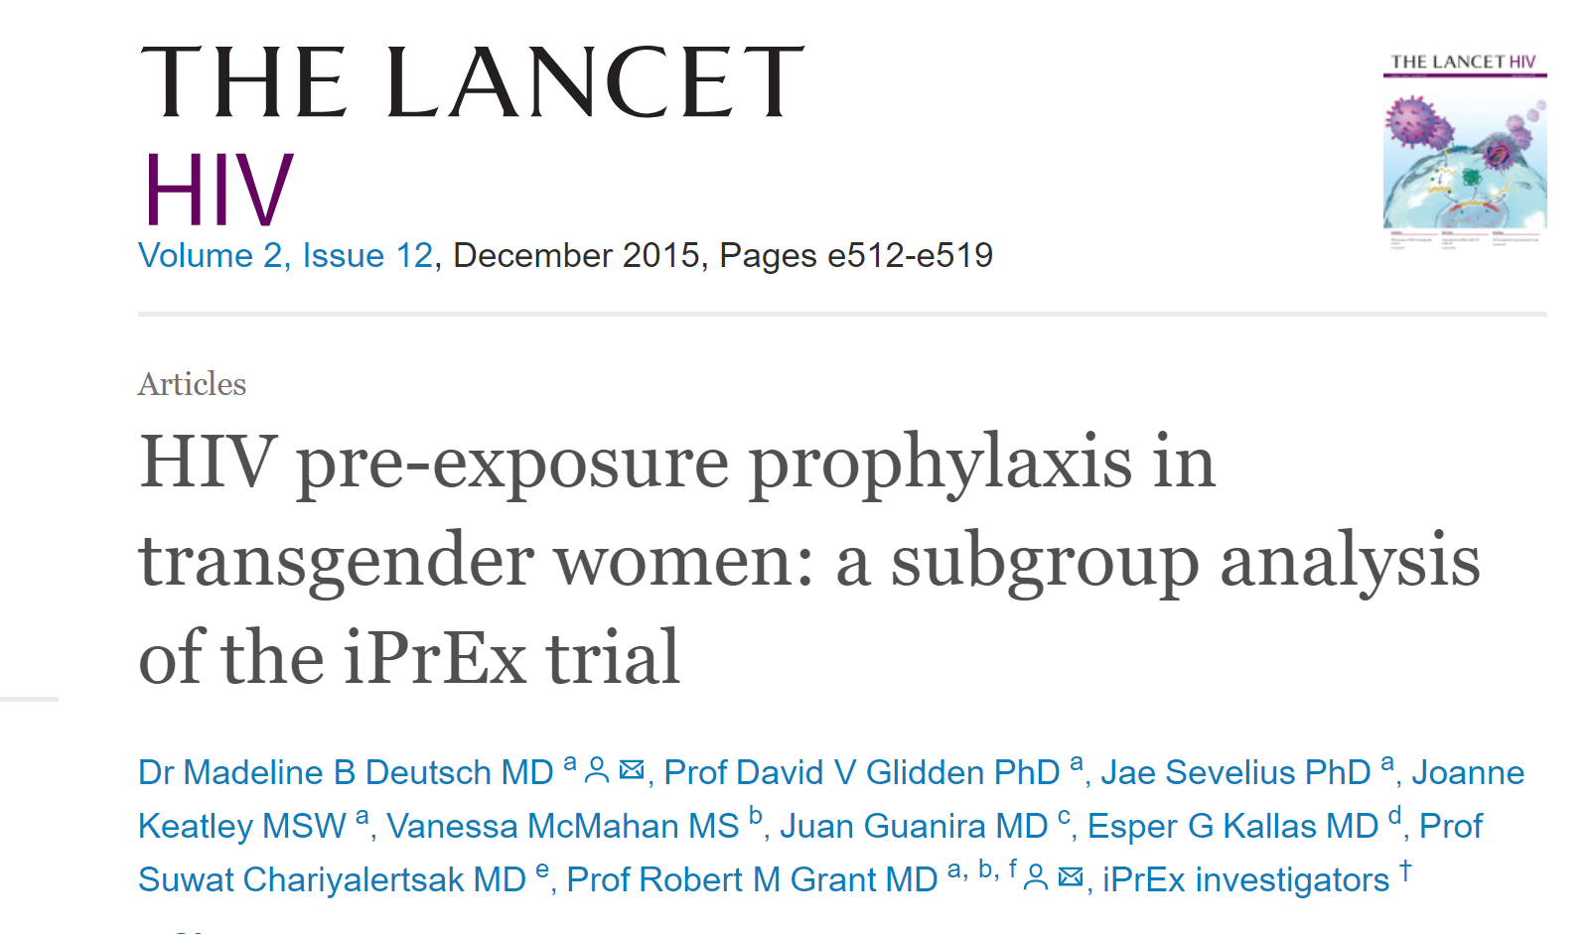
PrEP Efficacy in Transgender Women
Trans women: 339/2499 (14%)
Lack of efficacy: HR 1.1
Low adherence to TDF 18%
TFV-DP detected in no trans women at seroconversion
No seroconversions observed in trans women with TDP levels on ≥ 4 pills/week
Hormone use associated with lower TFV-DP levels
Adherence? Interactions?

Slide 16
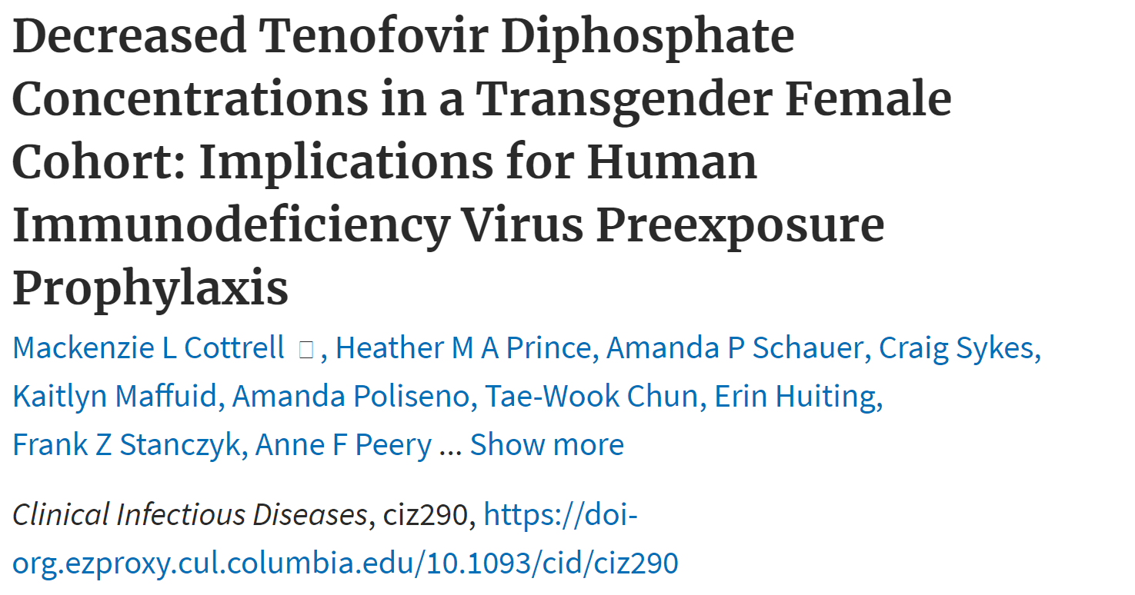
PrEP Efficacy in Transgender Women
*Estrogen levels do not change with TDF/FTC*
Serum tenofovir levels are reduced in the presence of estrogen
Clinical significance is not known
Transgender women on hormones may need greater adherence to oral PrEP
Hiransuthikul A et al. J Int AIDS Soc. 2019; Hendrix et al. HIV4RP 2018 #OA23.03; Cottrell ML, et al. CID 2019.

Slide 17
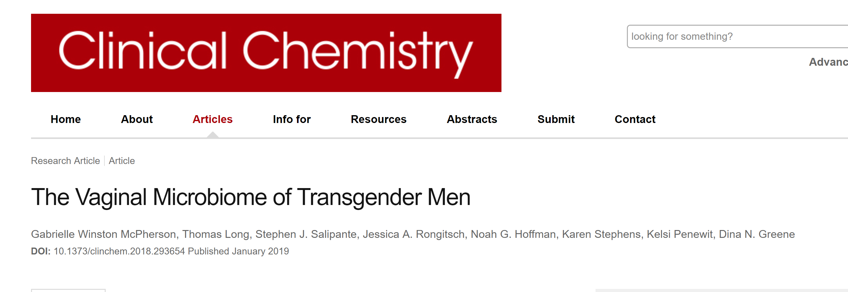
More to Consider

Slide 18
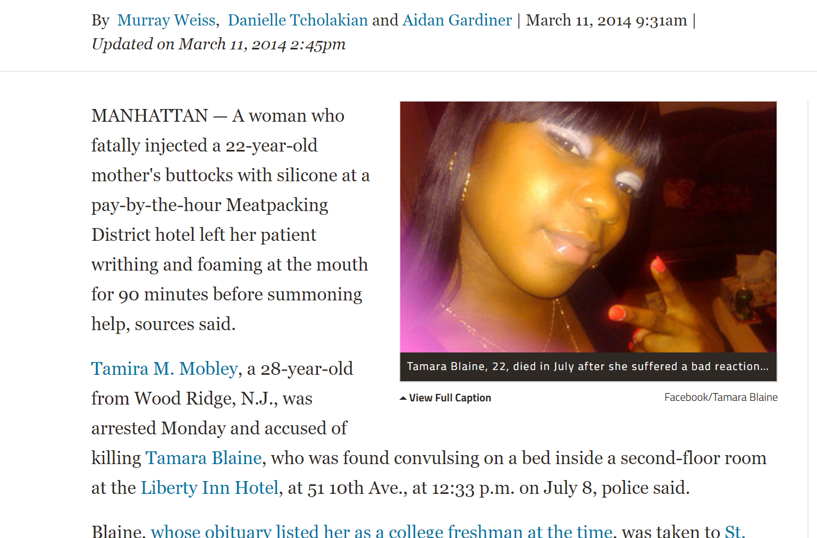
More to Consider
Woman Killed 22-Year-Old With Silicone Butt Injections,
Police Say

Slide 19
Assess PrEP Eligibility
Linkage to PrEP
Initiation of PrEP
Adherence & Persistence
Retention
PrEP Care Continuum

Slide 20
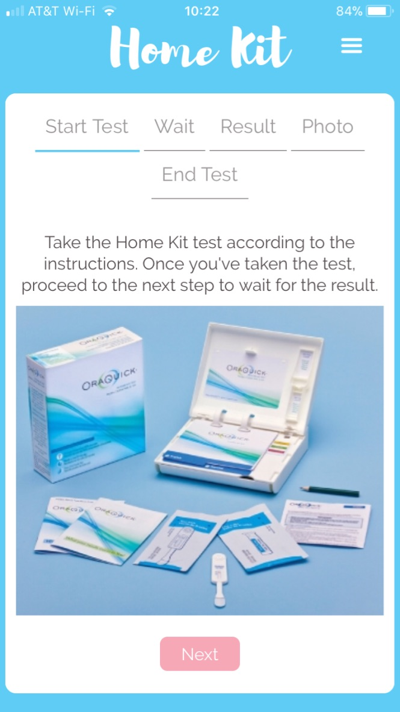
LITE Study*
Enrollment: 1,100 HIV uninfected transgender women in 6 cities, eastern and southern United States
Study visits: every 3mo. for 24 months (facility-based or online)
Survey + oral HIV testing every 3 months
STI testing inc. self-collected swabs every 12 months
App-based GPS data collection
*Leading Innovation for Transgender Women’s Health and Empowerment

Slide 21
Indications for PrEP among LITE Participants
Notes:
Modifid CDC criteria includes STI, partner living with HIV, current sex work, CRAI with last parnter

Slide 22
PrEP continuum among Transgender Women
*Poster TUPEC482
Notes:
Modifid CDC criteria includes STI, partner living with HIV, current sex work, CRAI with last parnter

Slide 23
PrEP Continuum for Transgender Men
USA online survey conducted (2017) among 1808 transmasculine individuals, ages 18-60
Almost one quarter of the sample (n = 439; 24.3%) met one or more criterion for PrEP
N=1808 | # | %
Any Condomless receptive anal or vaginal sex | 130 | 18.3%
Condomless receptive anal sex | 129 | 7.1%
Condomless vaginal receptive sex | 290 | 16.0%
STI history in past year | 99 | 5.5%
Sex work in past 6 months | 62 | 3.4%
Heroin use | 5 | 0.3%
5 or more cismale/trans female partners in past year | 103 | 5.7%
PrEP Eligible | 439 | 24.3%
Golub & Klein, JAIDS 2019

Slide 24
Barriers/Facilitators for PrEP in Trans People
Facilitators to PrEP
Trans-competent providers
Active provider engagement and assistance around PrEP
Community mobilization
Barriers to PrEP
Conflating TW with MSM
Mistrust of providers
Worried about side effects
Low HIV-risk perception
HIV stigma
Lack of trans-inclusive marketing
Concerns about hormone interactions
Consent (minors)
Pill size
Hormones prescribed at clinic
Materials/health promotion
Transgender-inclusive and gender affirming sexual health
Reisner et al., AIDS Behav. 2017; Restar et al., AIDS Behav. 2018; Wood et al., J Adolesc Health. 2017; Wilson et al., Global Public Health 2019; Klein & Golub. AIDS Patient Care and STDs 2019

Slide 25
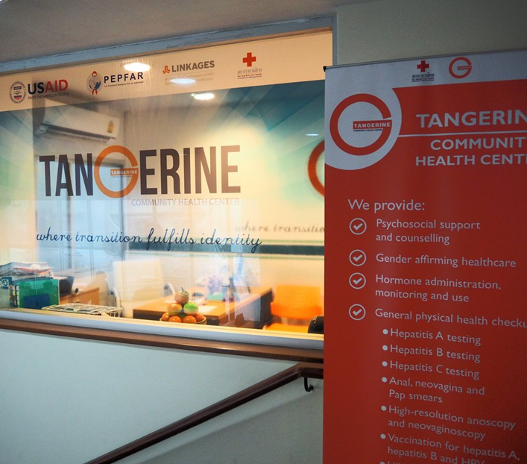
Affirming Spaces
First impressions are important
Assess and change current clinical environment
Intake forms inclusive of multiple gender identities and sexualities
Affirm gender: Use chosen names and pronouns
Knowledgeable providers
Assess psychosocial/material needs
Use trans images - on education materials, brochures, website
Gender neutral/inclusive bathrooms
Hire trans-identified staff
Tangerine Clinic, trans-led hormone integrated
sexual health, Thailand

Slide 26
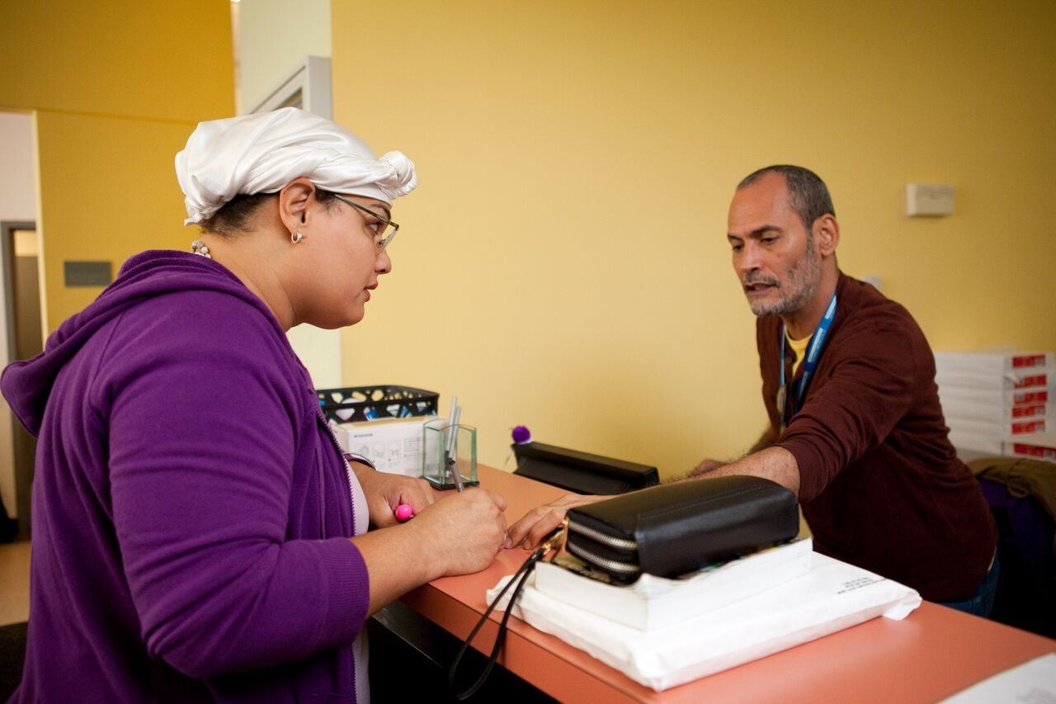
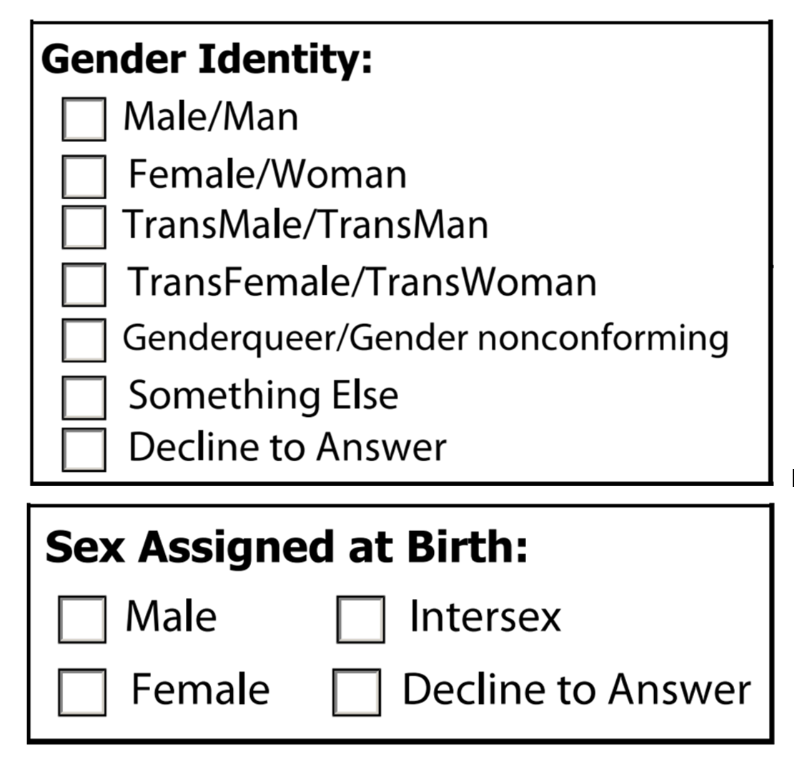

Slide 27
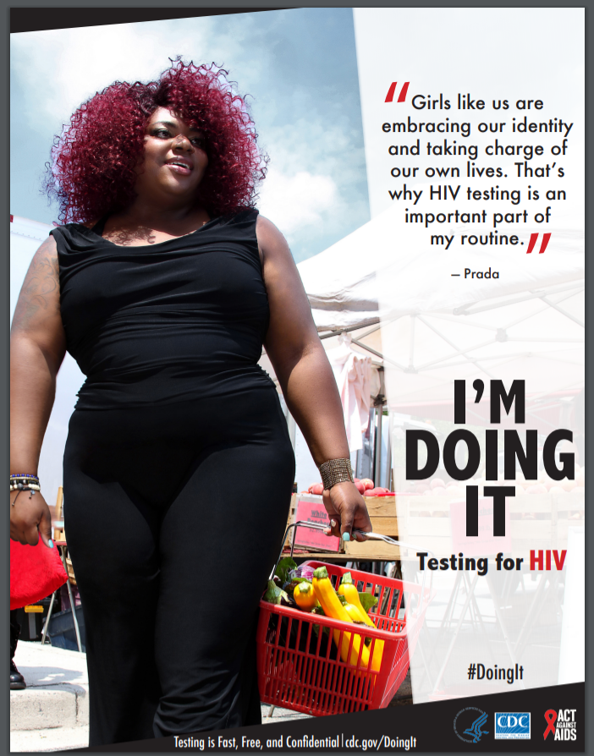
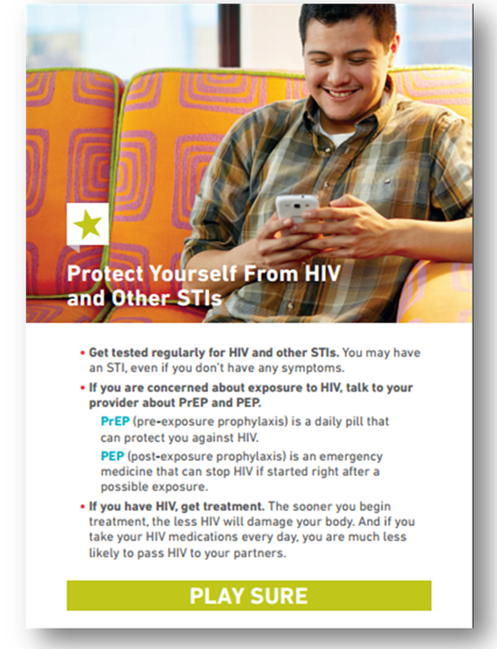
HIV Screening
HIV Testing Among Transgender Women and Men — 27 States and Guam, 2014–2015 (Pitasi MA, et al MMWR 2017)

Slide 28
Notes:
Again, taking DOHMH is focusing on general wellness.
marketing campaign—BARE IT ALL
Focus group process included trans people who were paid for their time.
Citywide campaign that encourages LGBTQ NYers to open up to their doctors about everything that affects their health
Campaign goals:
Addressed LGBTQ health concerns, beyond HIV and other sexual health issues
Empowered LGBTQ New Yorkers to seek the care they need and deserve
Provided a resource for LGB and TGNC New Yorkers seeking care from LGBTQ-knowledgeable providers

Slide 29
Scaling up PrEP

Slide 30
Projects in Progress
PrEP - 3 demonstration studies (18+)
TRIUMPH Project (“Trans Research-Informed communities United in Mobilization for the Prevention of HIV”)
The Stay Study: A Demonstration Project Advancing PrEP Delivery in the San Francisco Bay Area Transgender Community
iM-PrEPT! Study
PrEP clinical observation studies
FIRED UP (“Furthering Investigation into Retention, Engagement and Dynamics of Utilization of PrEP”)
HIV Testing
Project Moxie (trans youth 15-24)
HPTN 091: Integrating HIV Prevention, Gender-Affirmative Medical Care, and Peer Health Navigation to Prevent HIV Acquisition

Slide 31
Take Home Messages
Trans people experience disproportionate risk for HIV
Challenges exist with HIV prevention access
Gender affirmative care essential to PrEP scale-up
What is needed
Uniform collection of gender identity data
Meaningful inclusion of trans people in research
Not just about PrEP, understand social and structural vulnerabilities to HIV and PrEP access and uptake

Slide 32
Acknowledgements
Callen-Lorde Community Health Center
Ali Harris
Zil Goldstein
Fenway Health
Sari Reisner
Ken Mayer
Johns Hopkins University
Andrea Wirtz
Univ of North Carolina School of Medicine
Tonia Poteat
New York City DOHMH
Demetre Daskalakis, Stacey Wilking, Adriana Andaluz
Columbia University
Mary Ann Chiasson
University of California San Diego
Ayden Scheim
Hunter College
Sarit Golub
Gus Klein

